Slide 1



UNIT 2: Home is where heart is
Kira’s house

Slide 2

Check your knowledge. SELF CHECK.
https://www.e-sfera.hr/dodatni-digitalni-sadrzaji/63d6faea-8e63-40e5-a374-d8f9eff3a5c7/

Slide 3
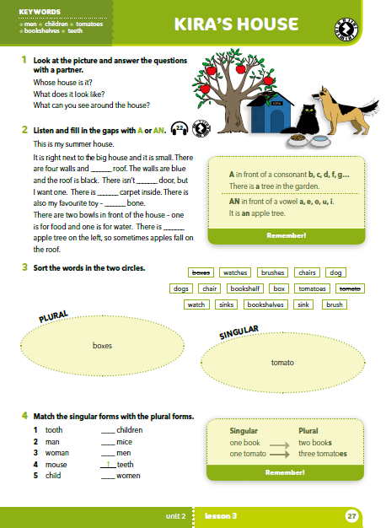
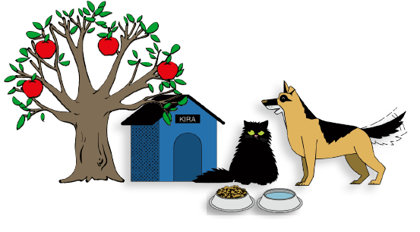
Whose house is it?
What does it look like?
What can you see around the house?

Slide 4
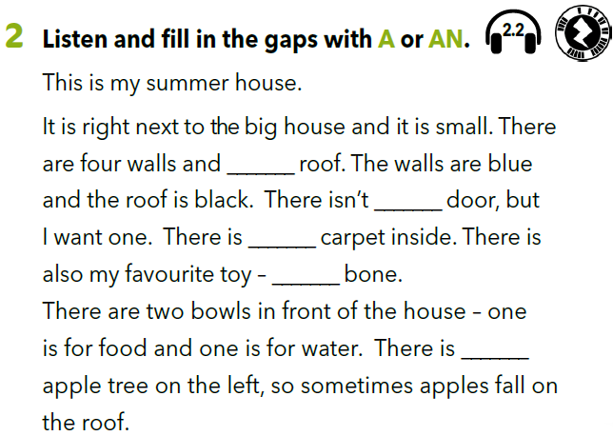

https://www.e-sfera.hr/dodatni-digitalni-sadrzaji/2cbc86e8-762c-4936-aba1-fff3ae7641fb/
a
a
a
a
an

Slide 5
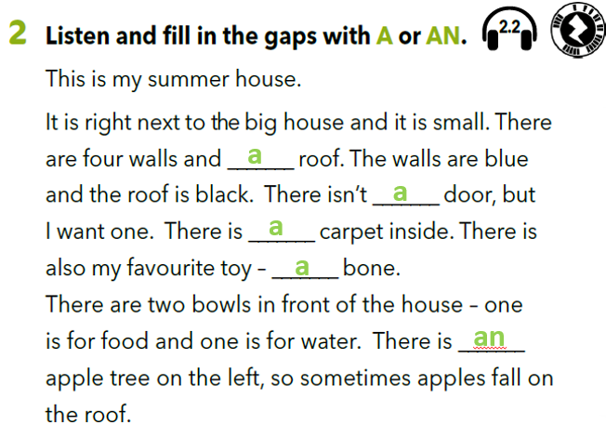
Underline the first letters of the words that follow the words a or an.

Slide 6
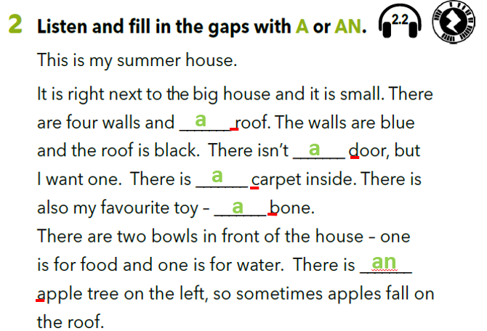
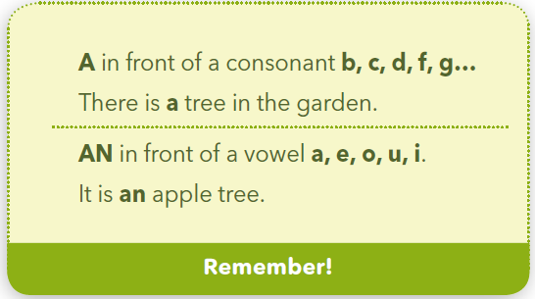
Think!
When do we use a?
When do we use an?
We use abefore words that start with a consonant (e.g. b, c, d, f, g…).
We use an before words that start with a vowel (e.g. a, e, i, o, u).

Slide 7
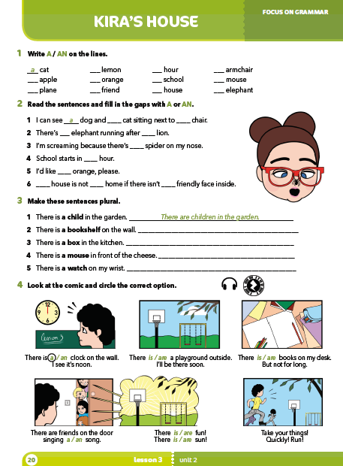
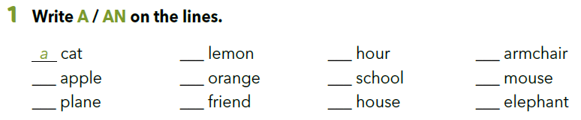
Workbook p 20.
a
an
*
an
an
an
a
a
a
a
a
an
*We don’t pronounce ”h” in the word ”hour”, the word starts with a vowel sound.

Slide 8
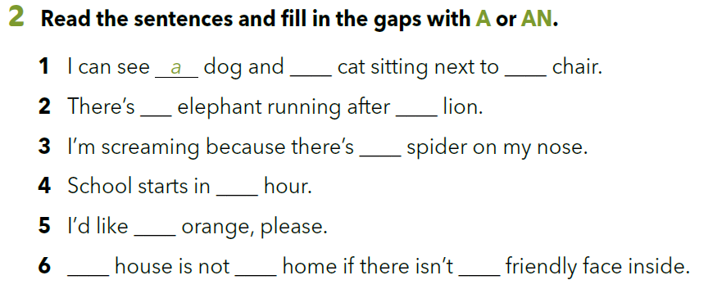
a
a
an
a
a
an
an
A
a
a

Slide 9
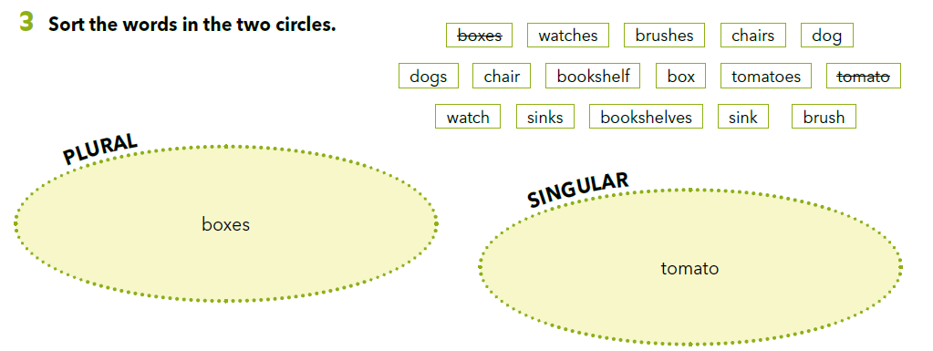
Sort the words into the correct category (plural or singular).
(plural – množina; singular – jednina).

Slide 10
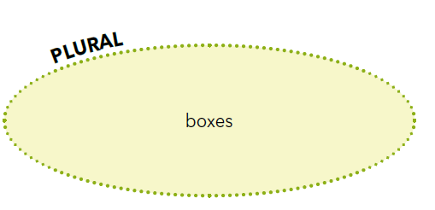
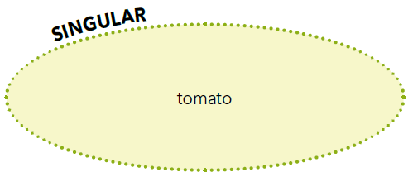
watches
brushes
chairs
dogs
tomatoes
sinks
bookshelves
dog
chair
bookshelf
box
watch
sink
brush

Slide 11
Which of the nouns in plural finish with -s?
Most of the nouns which end in a consonant:
book → books
dog → dogs

Slide 12
Which of the nouns in plural finish with -es?
Nouns which end in a vowel.
tomato → tomatoes
Nouns which finish with -x, -sh, -ch.
box → boxes
brush → brushes

Slide 13
What’s special about this pair?
a bookshelf → bookshelves
a bookshelf → bookshelves

Slide 14
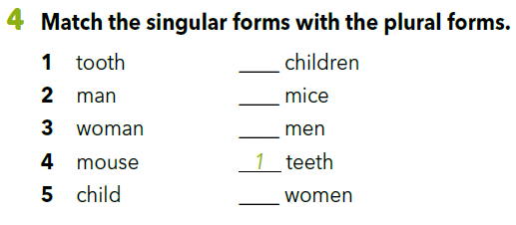
Some nouns have irregular plural.
5
4
2
3

Slide 15
Let’s practise!
https://wordwall.net/embed/04f0bc2f1fc24d94a2f60d37b409cc75?themeId=0&templateId=10%27%20frameborder=%270

Slide 16
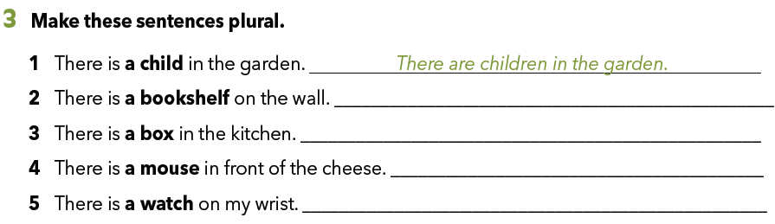
Workbook p 20.
There are bookshelves on the wall.
There are boxes in the kitchen.
There are mice in front of the cheese.
There are watches on my wrist.

Slide 17
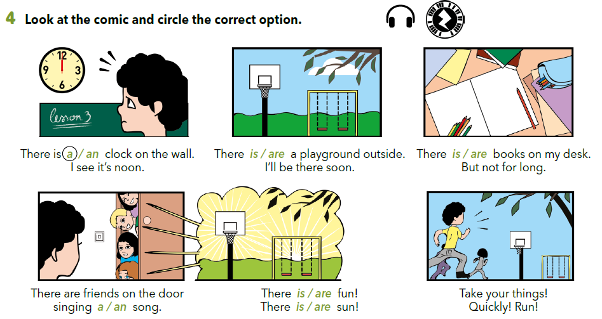

Slide 18
SELF CHECK
https://www.e-sfera.hr/dodatni-digitalni-sadrzaji/2cbc86e8-762c-4936-aba1-fff3ae7641fb/

